Slide 2
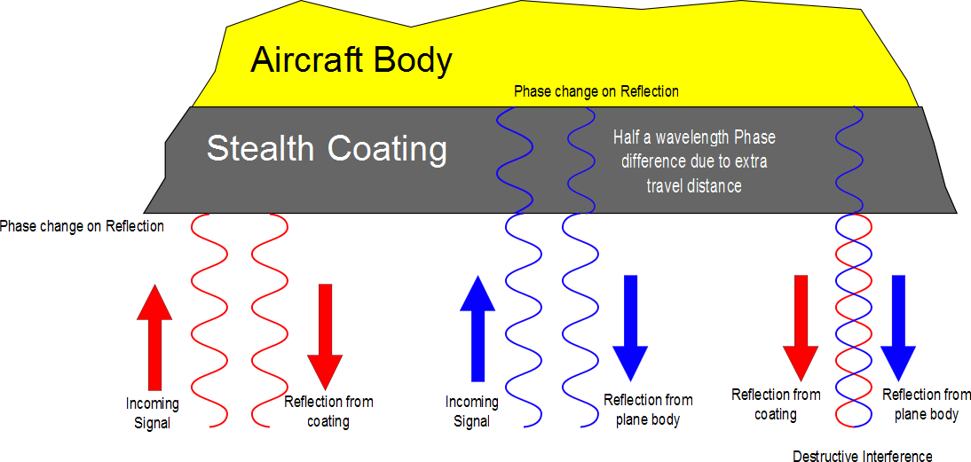

Slide 3
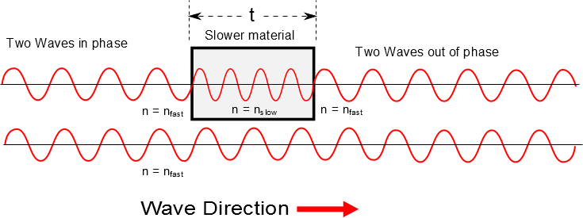

Slide 4
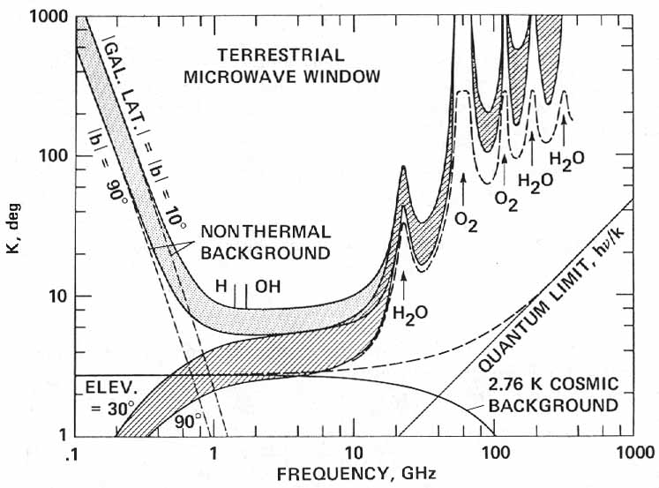

http://history.nasa.gov/CP-2156/p359.htm

Slide 5

Phase Shift
No Phase Shift
n=1
n>1
n=1

Slide 6
A thin film of oil (n=1.25) is located on a smooth wet pavement. When viewed perpendicular to the pavement, the film reflects most strongly red light at 640nm and reflects no blue light at 512nm . How thick is the oil film?

Slide 7
Loud Spot

Slide 8
Loud Spot
Full wavelength farther from the green wave center

Slide 9
Loud Spots

Slide 10
Dead Spot
Half a wavelength farther from the green wave center

Slide 11
Dead Spots

Slide 12
3m
2m
2m

Slide 13
Example of Beats

